Slide 1
Chapter 22
Network Layer:
Delivery, Forwarding,
and Routing

Slide 2
Forwarding vs. Routing
Forwarding: data plane
  Directing a data packet to an outgoing link
  Individual router using a forwarding table
Routing: control plane
  Computing paths the packets will follow
  Routers talking amongst themselves
  Individual router creating a forwarding table

Slide 3
  Routing vs. Forwarding:
    Routing:
      Filling and Updating routing tables
    Forwarding:
      making the decision which routes to use based on routing tables.
  Adaptive vs. Non-Adaptive Algorithms.
    Non-Adaptive Algorithms:
      Routing decision is based on pre-computed measurements or estimates and do not update the table based on current traffic and topology
    Adaptive Algorithms:
      Change their routing decisions to reflect changes in the topology and traffic.

Slide 4
DELIVERY
The network layer supervises the handling of the packets by the underlying physical networks.
We define this handling as the delivery of a packet.

Slide 5

Direct and indirect delivery

Slide 6


What is Routing?
A famous quotation from RFC 791
  “A name indicates what we seek.
  An address indicates where it is.
  A route indicates how we get there.”
  -- Jon Postel

Slide 7
UNICAST ROUTING PROTOCOLS
A routing table can be either static or dynamic.
A static table is one with manual entries.
A dynamic table is one that is updated automatically when there is a change somewhere in the Internet.
A routing protocol is a combination of rules and procedures that lets routers in the Internet inform each other of changes.

Slide 8

Popular routing protocols

Slide 9
Distance Vector Routing
Static Routing Algorithms
  Do not take into account actual network load.
Dynamic Routing Algorithms
  Taking into account actual network load
Distance Vector Routing:
Neighboring routers periodically exchange information from their routing tables.
Routers replace routes in their own routing tables anytime that neighbors have found better routes.
Information provided from neighbors
  Outgoing line used for destination
  Estimate of time or distance
    can be number of hops, time delay, packet queue length, etc.

Slide 10

Figure 22.14 Distance vector routing tables
22.<number>

Slide 11

Figure 22.15 Initialization of tables in distance vector routing
22.<number>

Slide 12

Note
In distance vector routing, each node shares its routing table with its
immediate neighbors periodically and when there is a change.
22.<number>

Slide 13

Figure 22.16 Updating in distance vector routing
22.<number>

Slide 14
Distance Vector Example: Step 0
Optimum 1-hop paths
Table for A
Dst | Cst | Hop
A | 0 | A
B | 4 | B
C | ∞ | –
D | ∞ | –
E | 2 | E
F | 6 | F
Table for B
Dst | Cst | Hop
A | 4 | A
B | 0 | B
C | ∞ | –
D | 3 | D
E | ∞ | –
F | 1 | F
E
C
3
1
F
1
2
6
1
D
A
3
4
B
Table for C
Dst | Cst | Hop
A | ∞ | –
B | ∞ | –
C | 0 | C
D | 1 | D
E | ∞ | –
F | 1 | F
Table for D
Dst | Cst | Hop
A | ∞ | –
B | 3 | B
C | 1 | C
D | 0 | D
E | ∞ | –
F | ∞ | –
Table for E
Dst | Cst | Hop
A | 2 | A
B | ∞ | –
C | ∞ | –
D | ∞ | –
E | 0 | E
F | 3 | F
Table for F
Dst | Cst | Hop
A | 6 | A
B | 1 | B
C | 1 | C
D | ∞ | –
E | 3 | E
F | 0 | F

Slide 15
Distance Vector Example: Step 2
Optimum 2-hop paths
Table for A
Dst | Cst | Hop
A | 0 | A
B | 4 | B
C | 7 | F
D | 7 | B
E | 2 | E
F | 5 | E
Table for B
Dst | Cst | Hop
A | 4 | A
B | 0 | B
C | 2 | F
D | 3 | D
E | 4 | F
F | 1 | F
E
C
3
1
F
1
2
6
1
D
A
3
4
B
Table for C
Dst | Cst | Hop
A | 7 | F
B | 2 | F
C | 0 | C
D | 1 | D
E | 4 | F
F | 1 | F
Table for D
Dst | Cst | Hop
A | 7 | B
B | 3 | B
C | 1 | C
D | 0 | D
E | ∞ | –
F | 2 | C
Table for E
Dst | Cst | Hop
A | 2 | A
B | 4 | F
C | 4 | F
D | ∞ | –
E | 0 | E
F | 3 | F
Table for F
Dst | Cst | Hop
A | 5 | B
B | 1 | B
C | 1 | C
D | 2 | C
E | 3 | E
F | 0 | F

Slide 16
Distance Vector Example: Step 3
Optimum 3-hop paths
Table for A
Dst | Cst | Hop
A | 0 | A
B | 4 | B
C | 6 | E
D | 7 | B
E | 2 | E
F | 5 | E
Table for B
Dst | Cst | Hop
A | 4 | A
B | 0 | B
C | 2 | F
D | 3 | D
E | 4 | F
F | 1 | F
E
C
3
1
F
1
2
6
1
D
A
3
4
B
Table for C
Dst | Cst | Hop
A | 6 | F
B | 2 | F
C | 0 | C
D | 1 | D
E | 4 | F
F | 1 | F
Table for D
Dst | Cst | Hop
A | 7 | B
B | 3 | B
C | 1 | C
D | 0 | D
E | 5 | C
F | 2 | C
Table for E
Dst | Cst | Hop
A | 2 | A
B | 4 | F
C | 4 | F
D | 5 | F
E | 0 | E
F | 3 | F
Table for F
Dst | Cst | Hop
A | 5 | B
B | 1 | B
C | 1 | C
D | 2 | C
E | 3 | E
F | 0 | F

Slide 17

Figure 22.19 Example of a domain using RIP
22.<number>

Slide 18
OSPF Overview
OSPF versus RIP
OSPF
Link state
Efficient routing updates (sends changes only)
No hop count limit
Fast Convergence
Path selection based on bandwidth
RIP
Distance vector
Copies entire routing table
Hop count limit of 15
Hold-down timers to prevent routing loops
Uses only hop count as metric

Slide 19
OSPF Overview
Concepts
OSPF is a Link-State Routing Protocol
Employs Dijkstra’s Shortest Path First (SPF) algorithm to calculate the path tree
Uses Metrics—path cost
Typically faster convergence than DVRPs

Slide 20
OSPF Overview
Terminology
Link
Link state
Link State (LS) or topological database
Area
OSPF Metric Cost
Routing table
Adjacencies database

Slide 21

Concept of link state routing
22.<number>

Slide 22

Figure 22.21 Link state knowledge
22.<number>

Slide 23

Figure 22.22 Dijkstra algorithm
22.<number>

Slide 24

Figure 22.23 Example of formation of shortest path tree
22.<number>

Slide 25

Table 22.2 Routing table for node A
22.<number>

Slide 26
22-4 MULTICAST ROUTING PROTOCOLS
In this section, we discuss multicasting and multicast routing protocols.
Topics discussed in this section:
Unicast, Multicast, and Broadcast
Applications
Multicast Routing
Routing Protocols
22.<number>

Slide 27
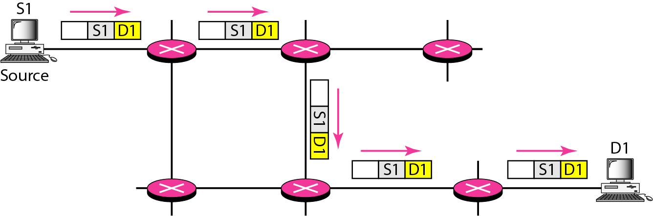
Figure 22.33 Unicasting
22.<number>

Slide 28
Note
In unicasting, the router forwards the received packet through
only one of its interfaces.
22.<number>

Slide 29
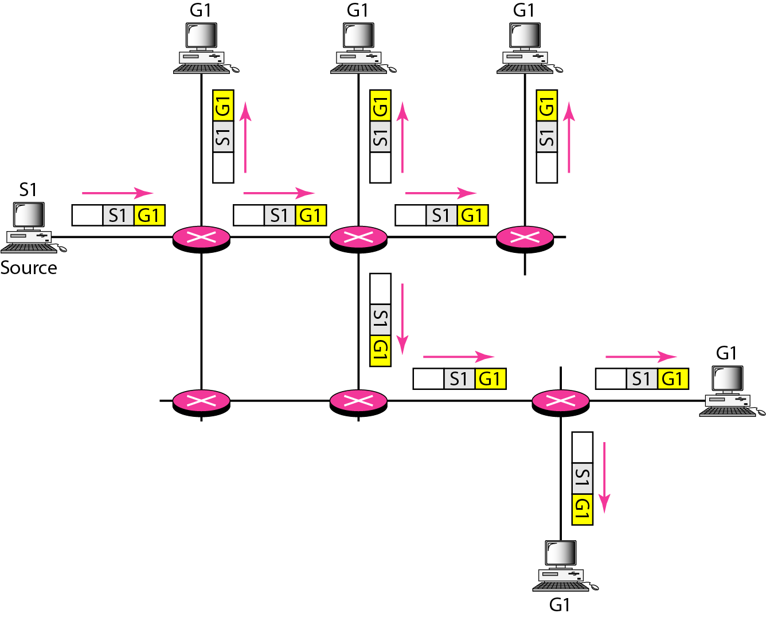
Figure 22.34 Multicasting
22.<number>

Slide 30
Note
In multicasting, the router may
forward the received packet
through several of its interfaces.
22.<number>

Slide 31
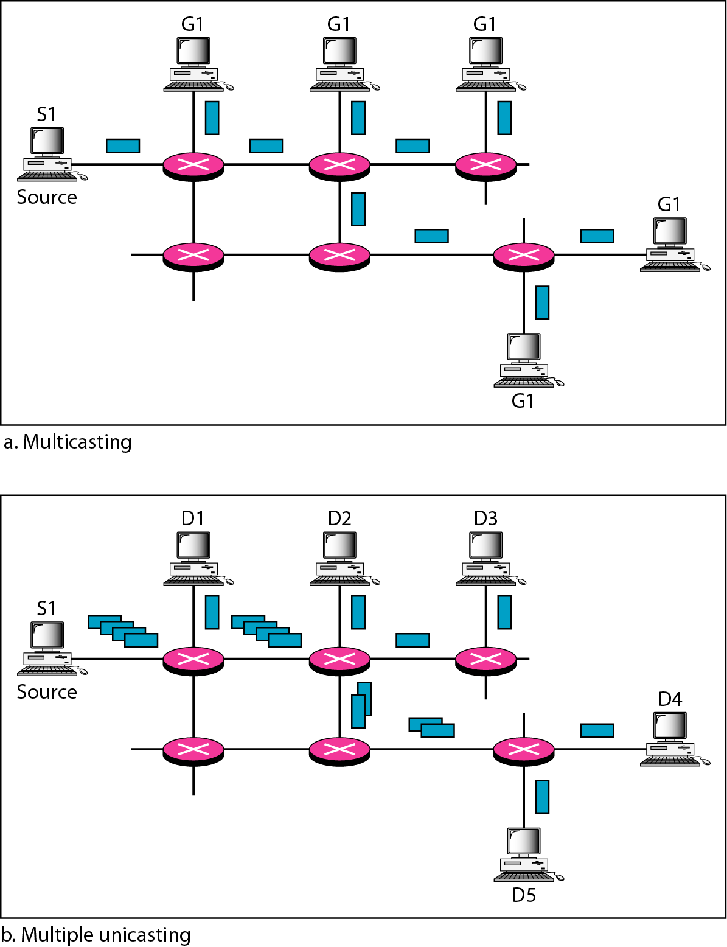
Figure 22.35 Multicasting versus multiple unicasting
22.<number>

Slide 32
Note
Emulation of multicasting through multiple unicasting is not efficient
and may create long delays,
particularly with a large group.
22.<number>

Slide 33
Note
In unicast routing, each router in the domain has a table that defines
a shortest path tree to possible destinations.
22.<number>

